Slide 1
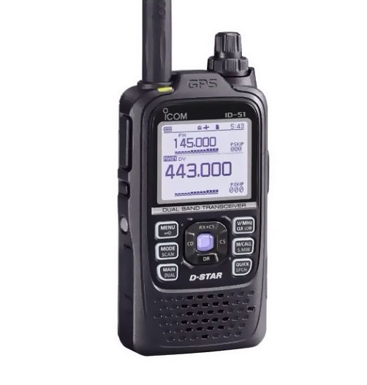
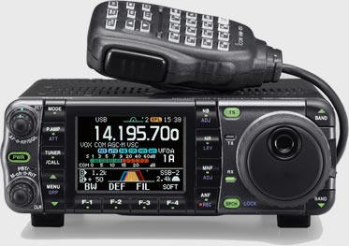
Technician Q&A and License Exam Session
Thurs 11/8 5:30 PM Broun Room 239
Interested in becoming a ham radio operator?
Come and get your technician license with us!
Study materials at hamstudy.org or by request
Bring $15 cash, Photo ID, calculator, pencils, SSN/FRN
Contact chase@auburn.edu
with any questions

