Slide 1
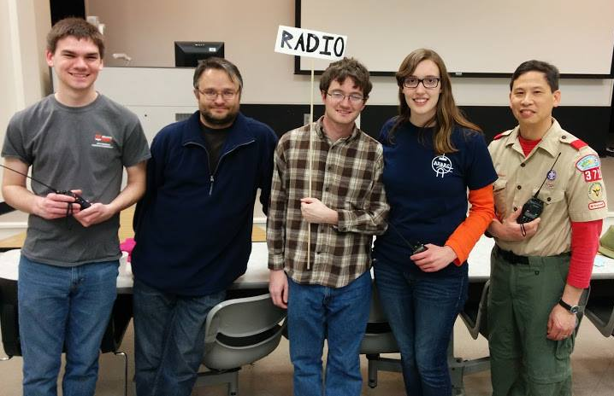
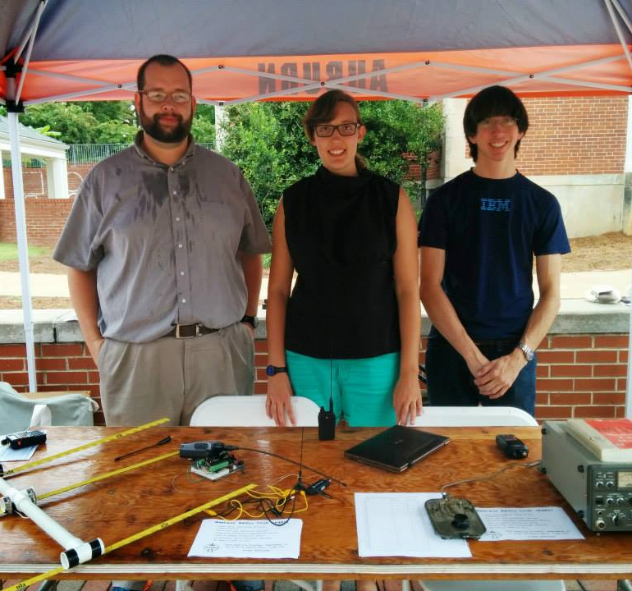
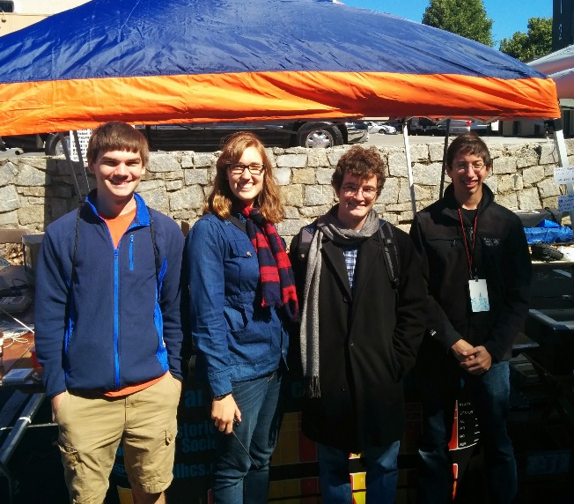
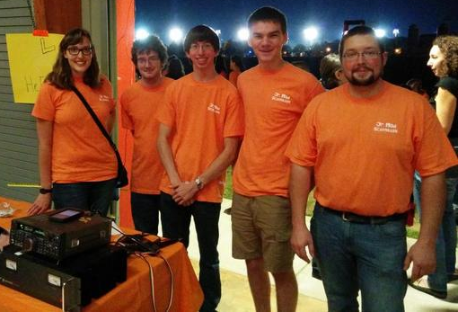
What on Earth is “radio club”?
Brought to you by the Auburn University Amateur Radio Club

Slide 2
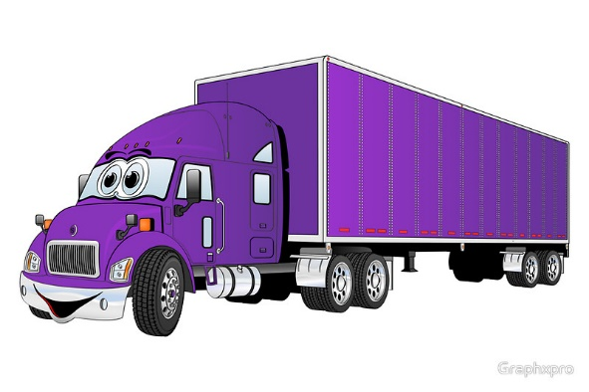
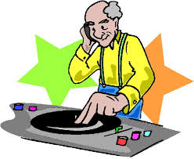
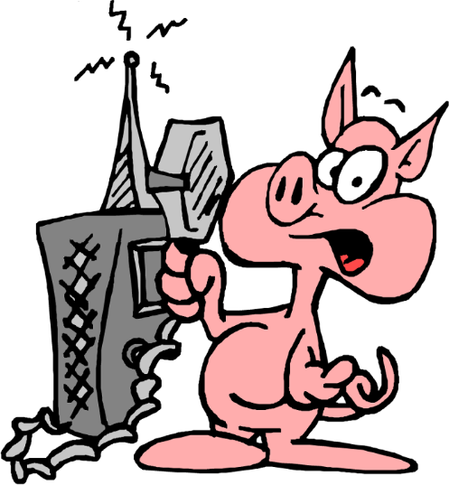
What’s amateur radio?
Totally not CB (citizen’s band)
Also not commercial radio (we are not WEGL)
About three million licensed amateurs worldwide
Stations set up in their homes or garages
Also called “Ham radio”
Notes:
http://ih2.redbubble.net/image.13104714.6279/flat,800x800,070,f.jpg
Cliparts.co
http://www.hcpl.net/sites/default/files/ham%20radio-pig.png

Slide 3
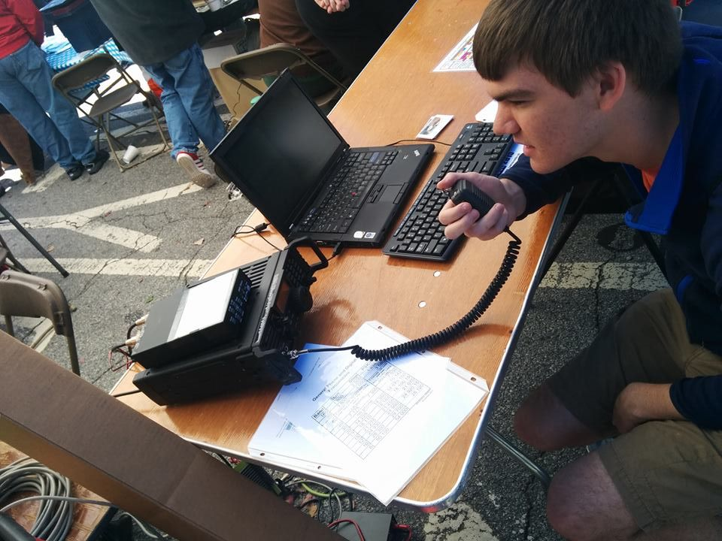
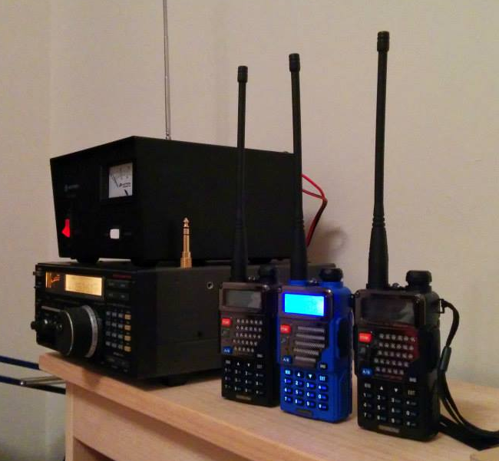
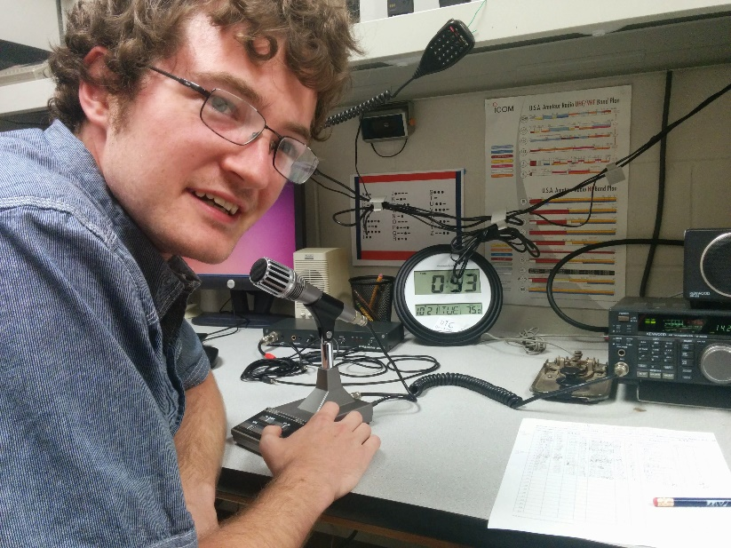
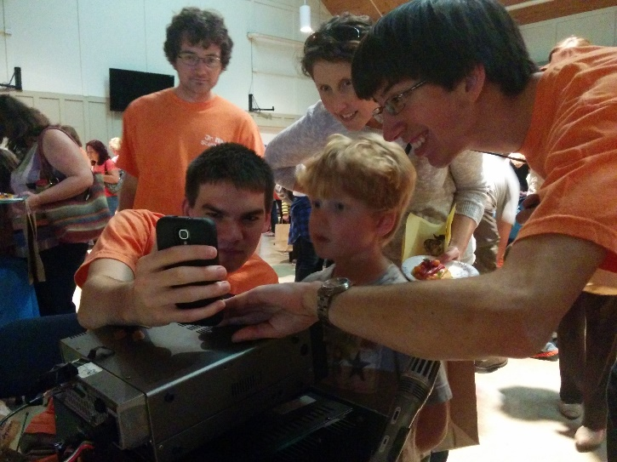
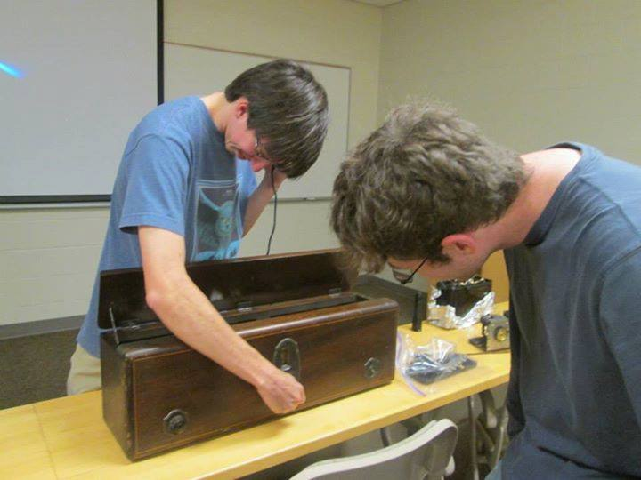
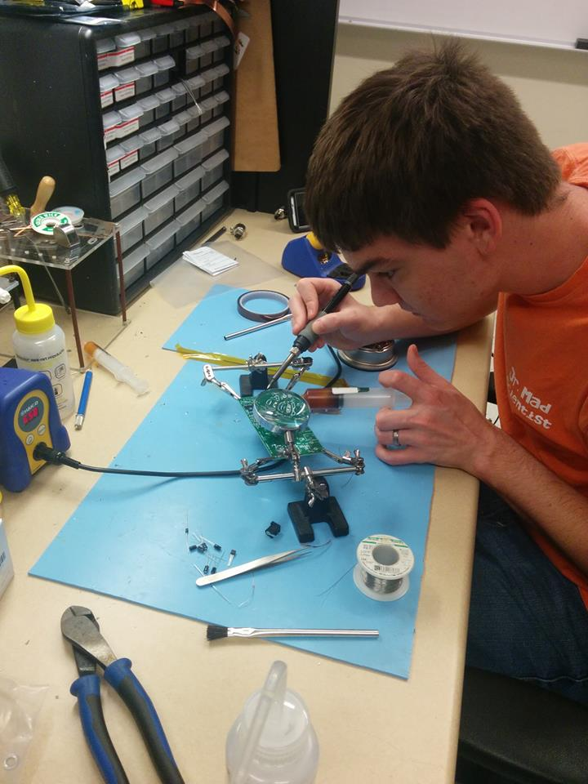
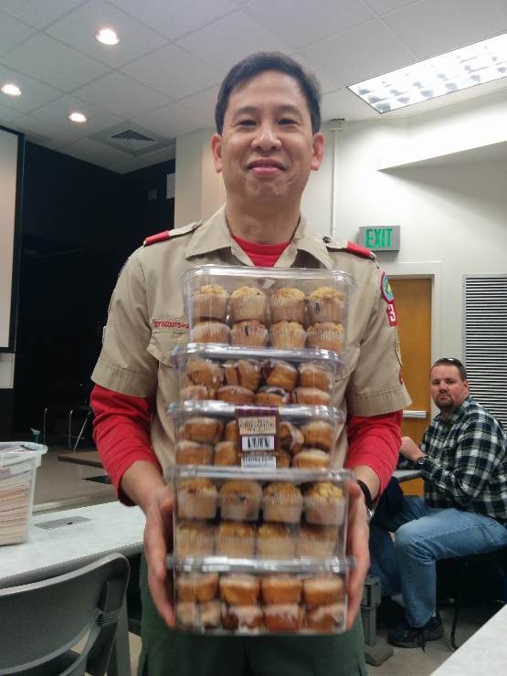
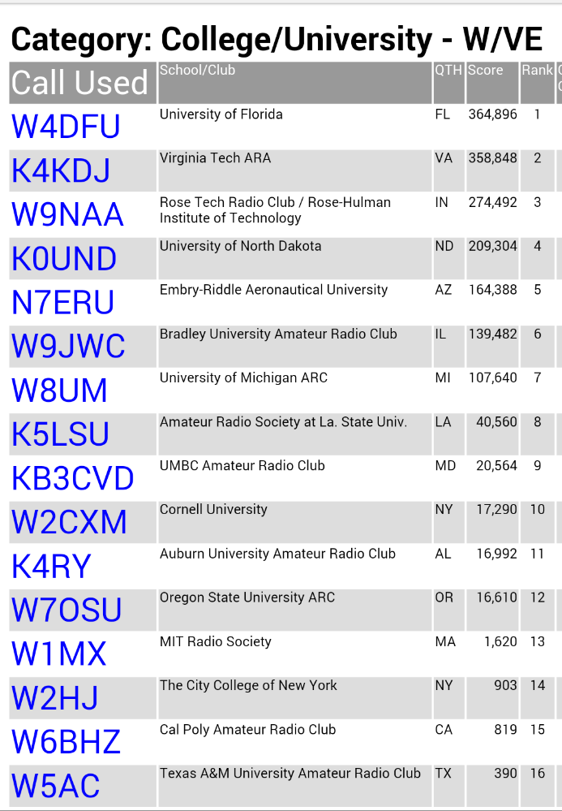
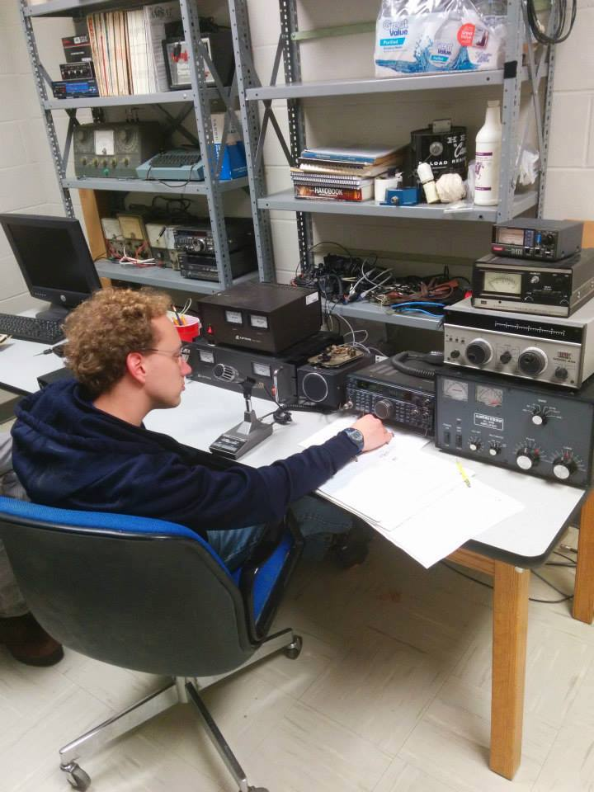
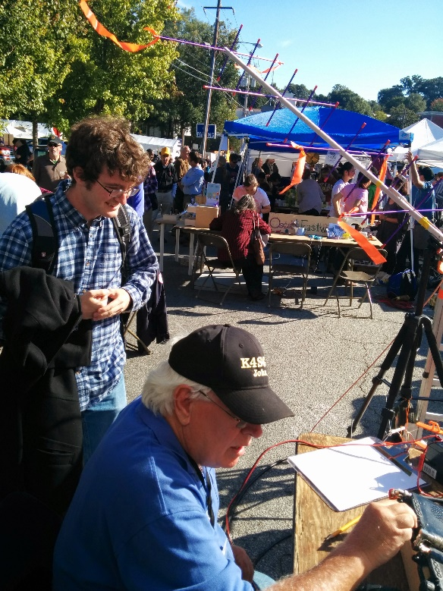
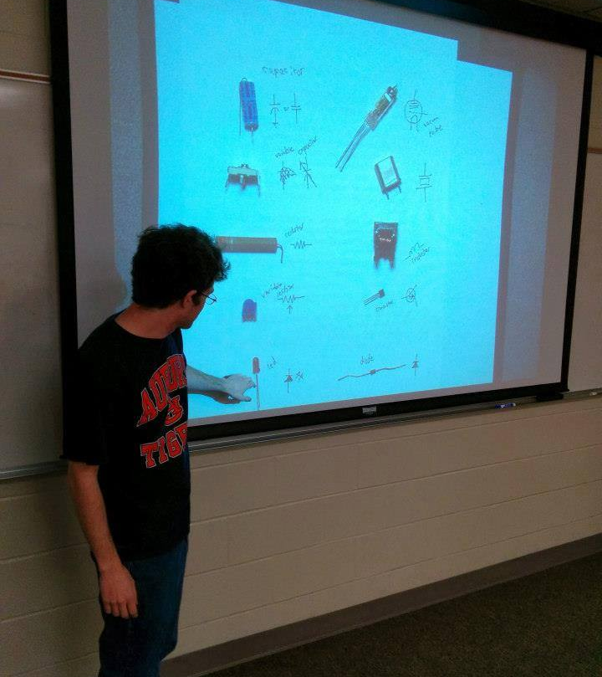
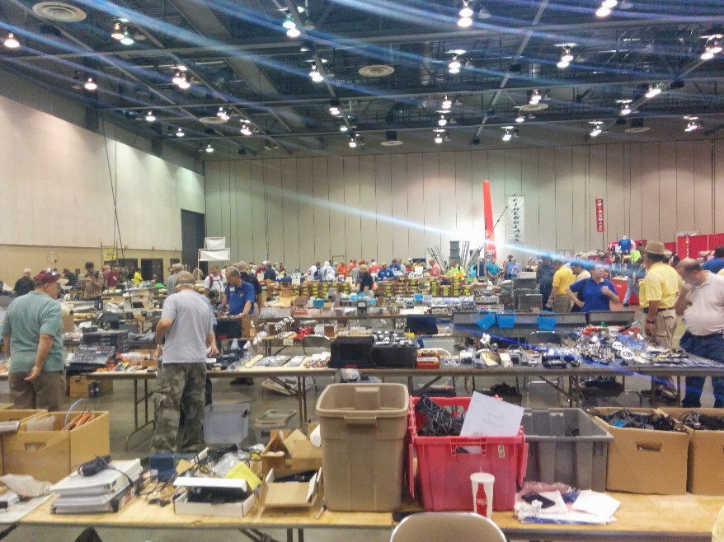
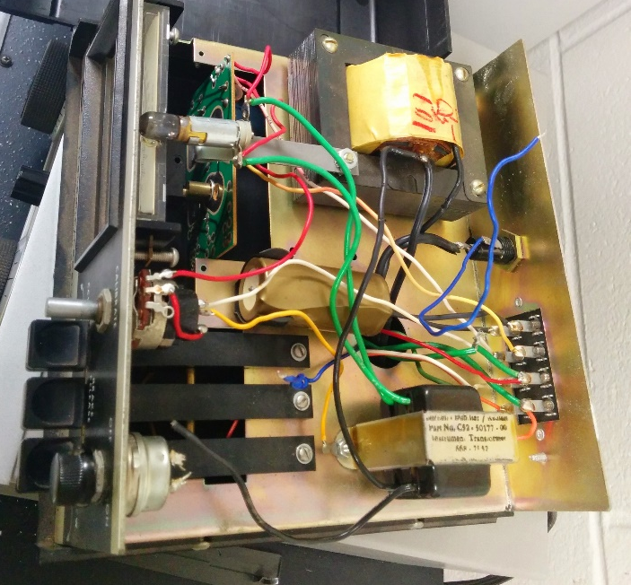
What does the club do?
Make Things
Build kits
Fix old stuff
Education
Merit Badge University
STEM festivals
Community Service
Emergency Preparedness Drills
Competitions
Contests
Meet People
Hamfests
Atlanta Maker Faire
Talking on the radio!
Eleventh in the nation!!!

Slide 4
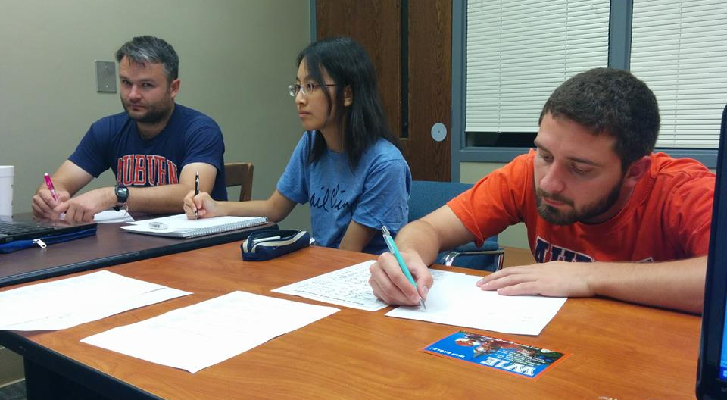
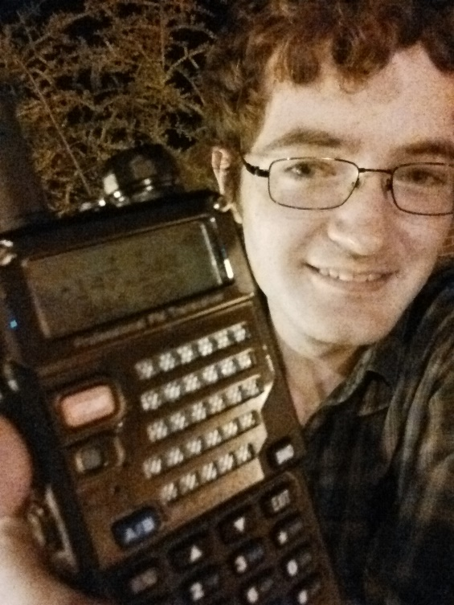
How do I get started?
Licenses
$15 per test
Question bank and answers online
Three levels of license: technician, general, extra
Getting a license = getting a callsign!
Radio
Handhelds are $20
Free handheld radio for passing general exam
Members can borrow equipment
...That’s it. You’re in.
But aren’t there dues?
No.

Slide 5
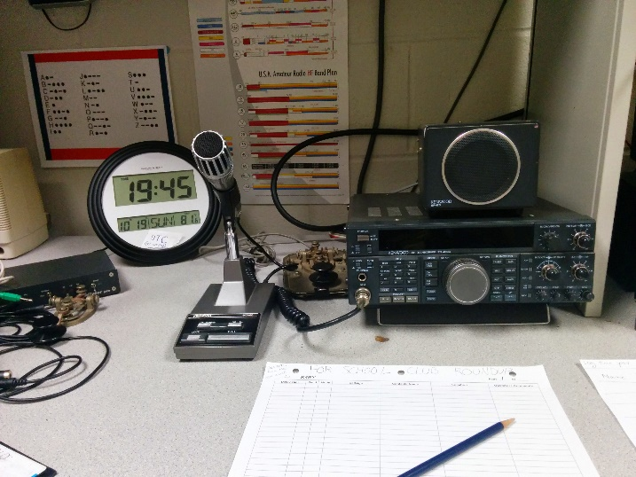
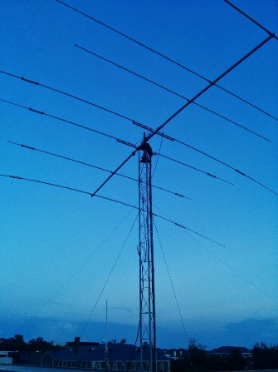
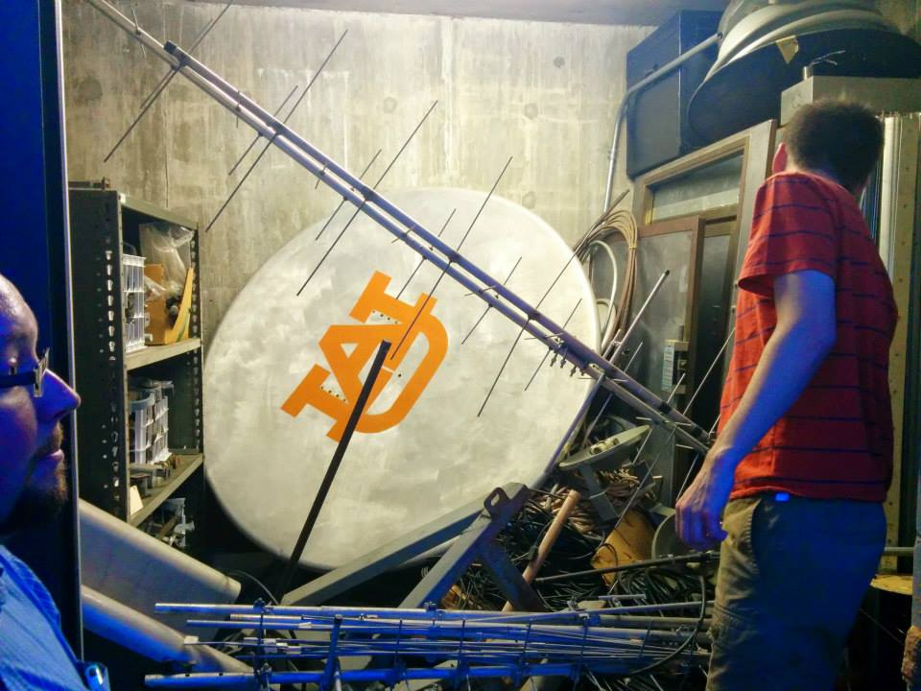
How do I stalk you guys?
Meetings: Tuesdays at 18:00 in Broun 235
Email list: http://mailman.eng.auburn.edu/mailman/listinfo/k4ry
Website: wiki.eng.auburn.edu/k4ry
AUInvolve: Amateur Radio Club (AUARC)
Facebook: facebook.com/k4ryarc
Twitter: @k4ryarc
On-air: 147.240 MHz (+pl 156.7 Hz) and 444.8 MHz (+pl 156.7Hz)

Slide 6
Orders of Business – 25th of August, 2015
Getting a snazzy banner
$50
Design on next slide
Planning future meeting times
Tuesday at 18:00?
Gel cell battery for repeater
Pick a time
Get permission
Volunteer Opportunity
Maker Faire & Robotics Competition
Lochapoka High School
T-Shirts, anyone? Bueller? Bueller?

