Slide 1
Today’s AU-CAICE Meeting
2/11/2025

Slide 2
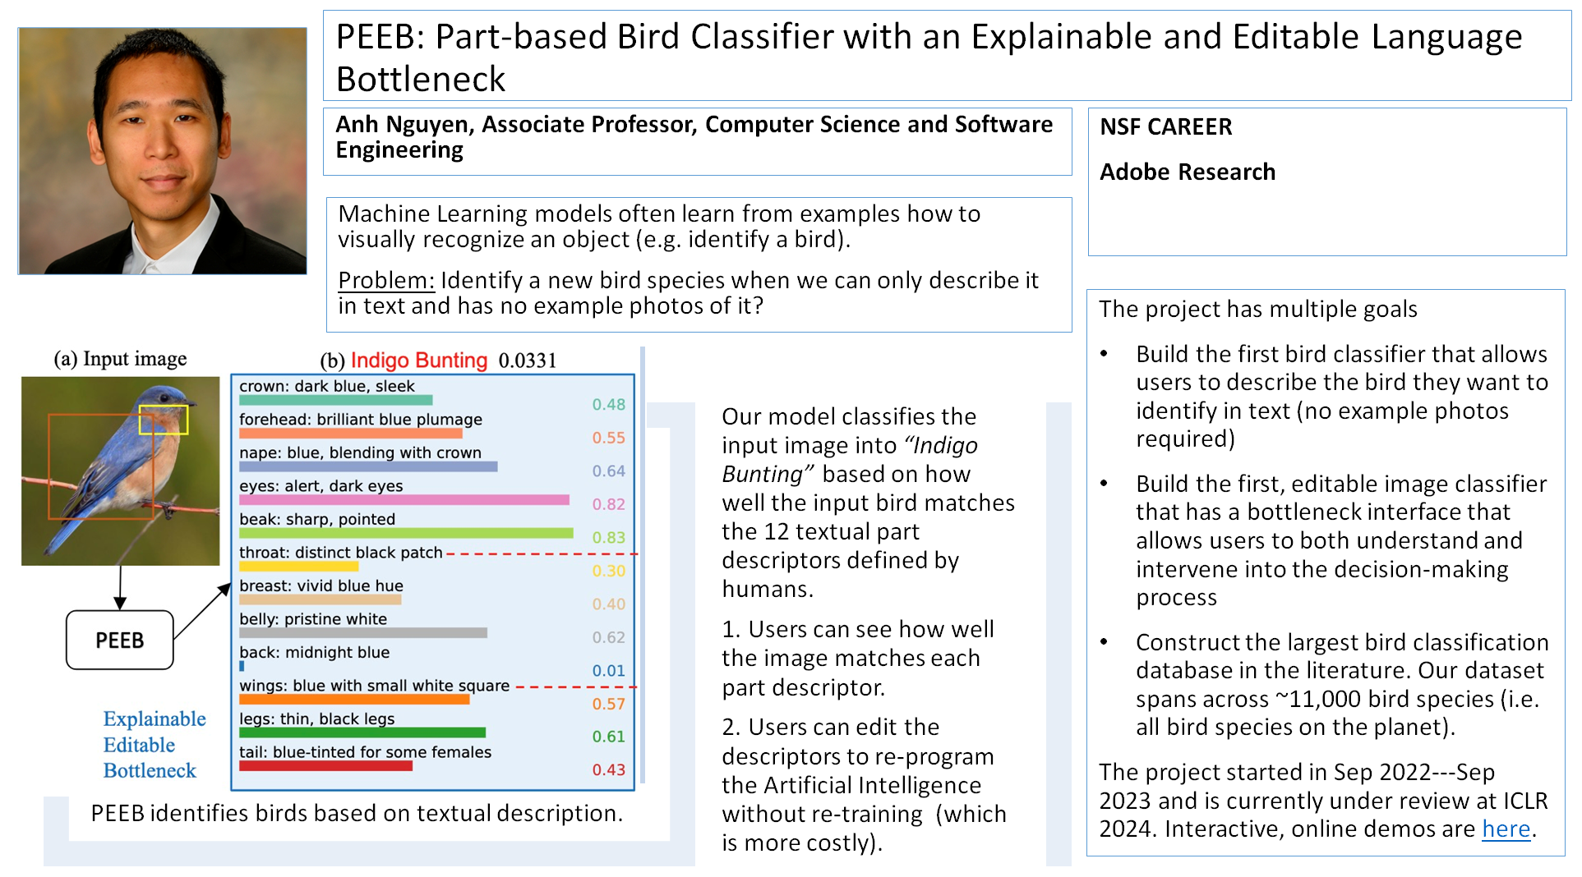
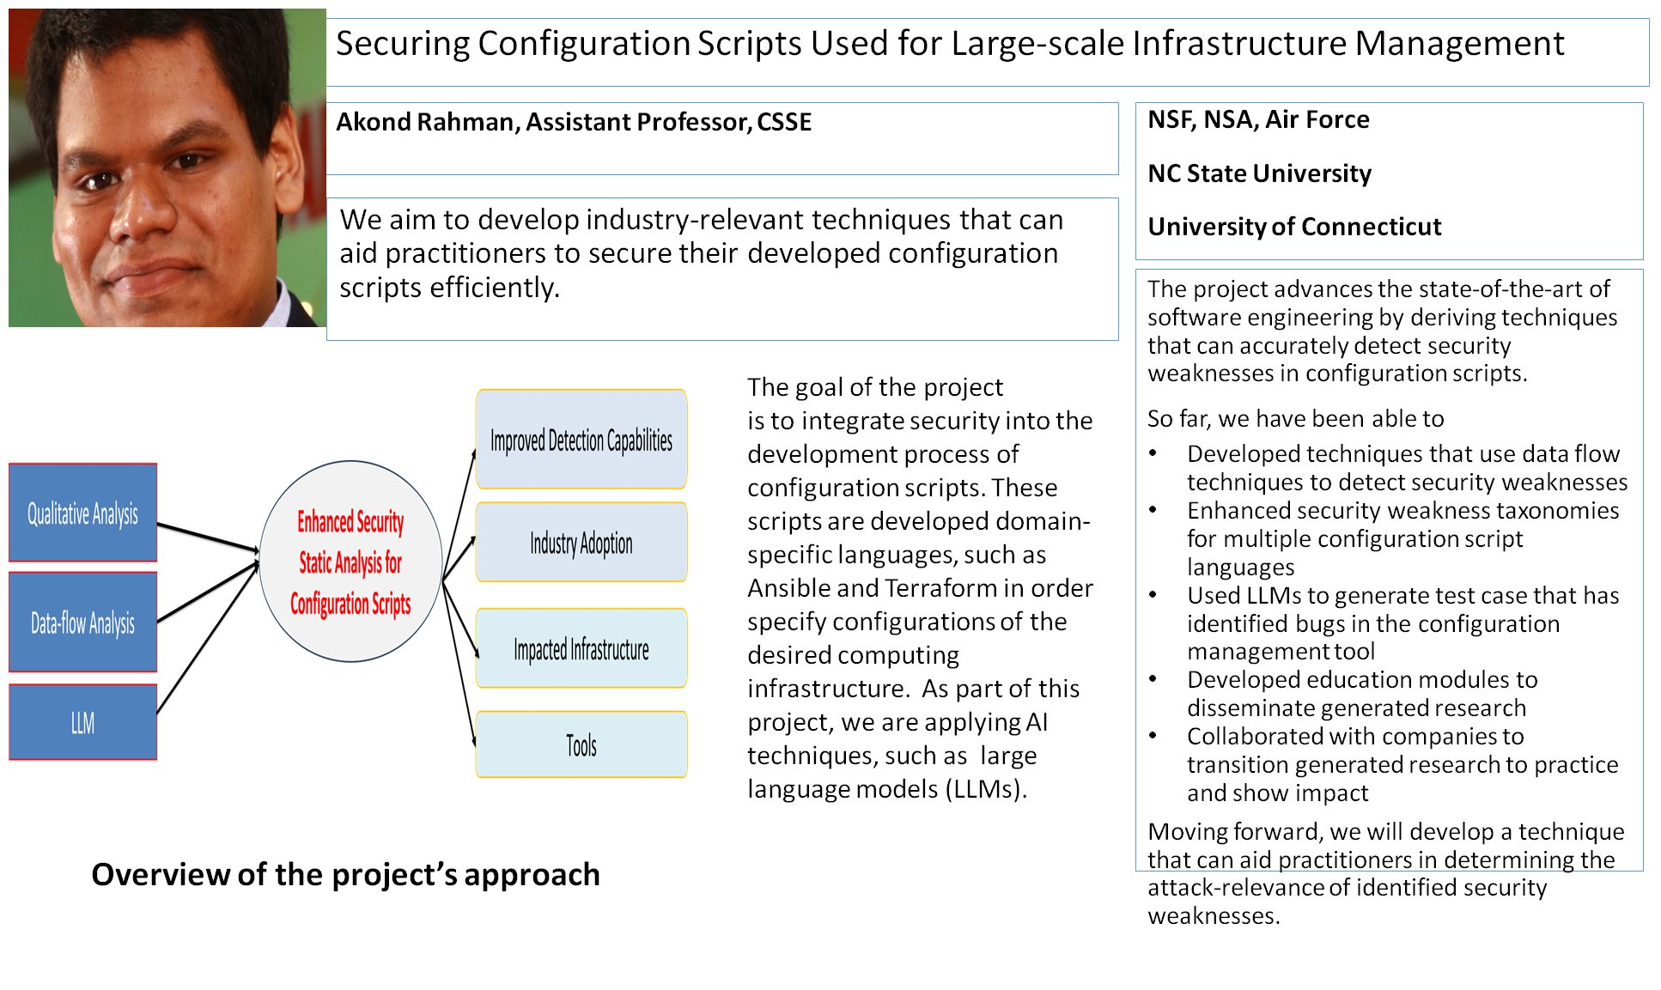
Topics
Please send me:
Your Research Slides
Your One Paragraph Bios
Some EPSCoR Opportunities
NSF 23-587: EPSCoR Collaborations for Optimizing Research Ecosystems Research Infrastructure Improvement Program (E-CORE RII) Deadline: July 15, 2025
NSF 23-588: EPSCoR Research Incubators for STEM Excellence Research Infrastructure Improvement (E-RISE II) Deadline: August 12, 2025
Other Opportunities
NSF 23-519: MRI Deadline: October 15, 2025
Smart Cities: City of Opelika
NAVSEA similar to N251-019 TITLE: Neuro-Symbolic Artificial Intelligence (AI) Agents for Cybersecurity Authority To Operate (ATO) Development
I3, Intuitive Research & Technology Corp.

Slide 3
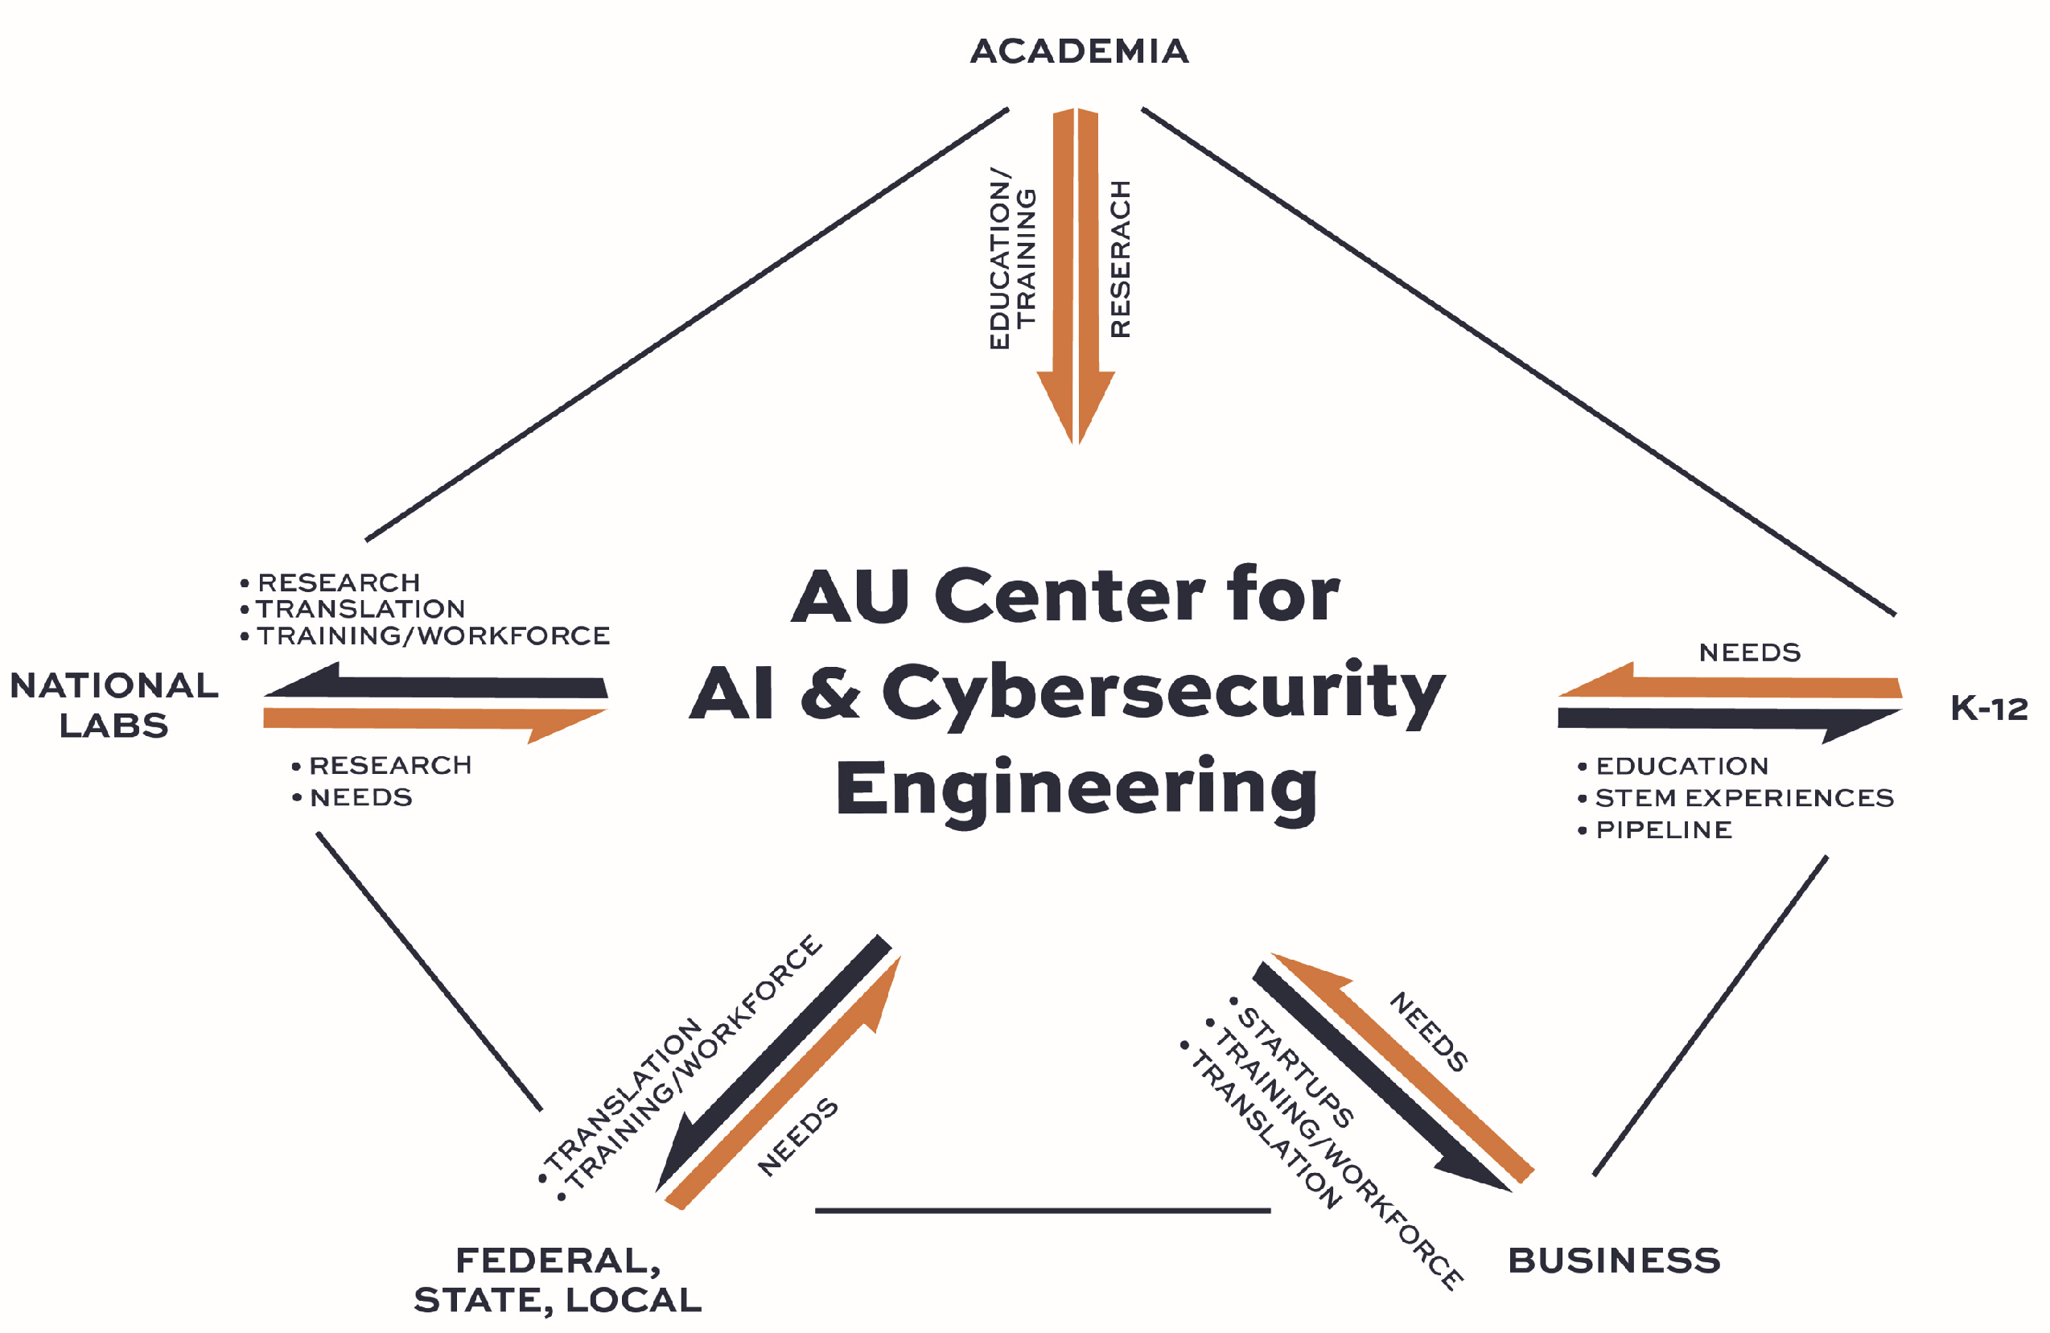
What We Have to Offer the AU-CAICE
We want our new AU-CAICE to be nationally recognized for being a team that successfully develops and cultivates scholarly, long-term, extramurally funded research & educational relationships and one that serves as a hub of an ecosystem that actively collaborates with:
Academia
Auburn University
SGCOE
Other Universities
K-12
Business/Industry
Federal, State, and Local Government
National Laboratories
First and foremost, we want the public to see our new center as a tool that can be used (leveraged) to improve their lives and provide them with a competitive advantage!!!

Slide 4
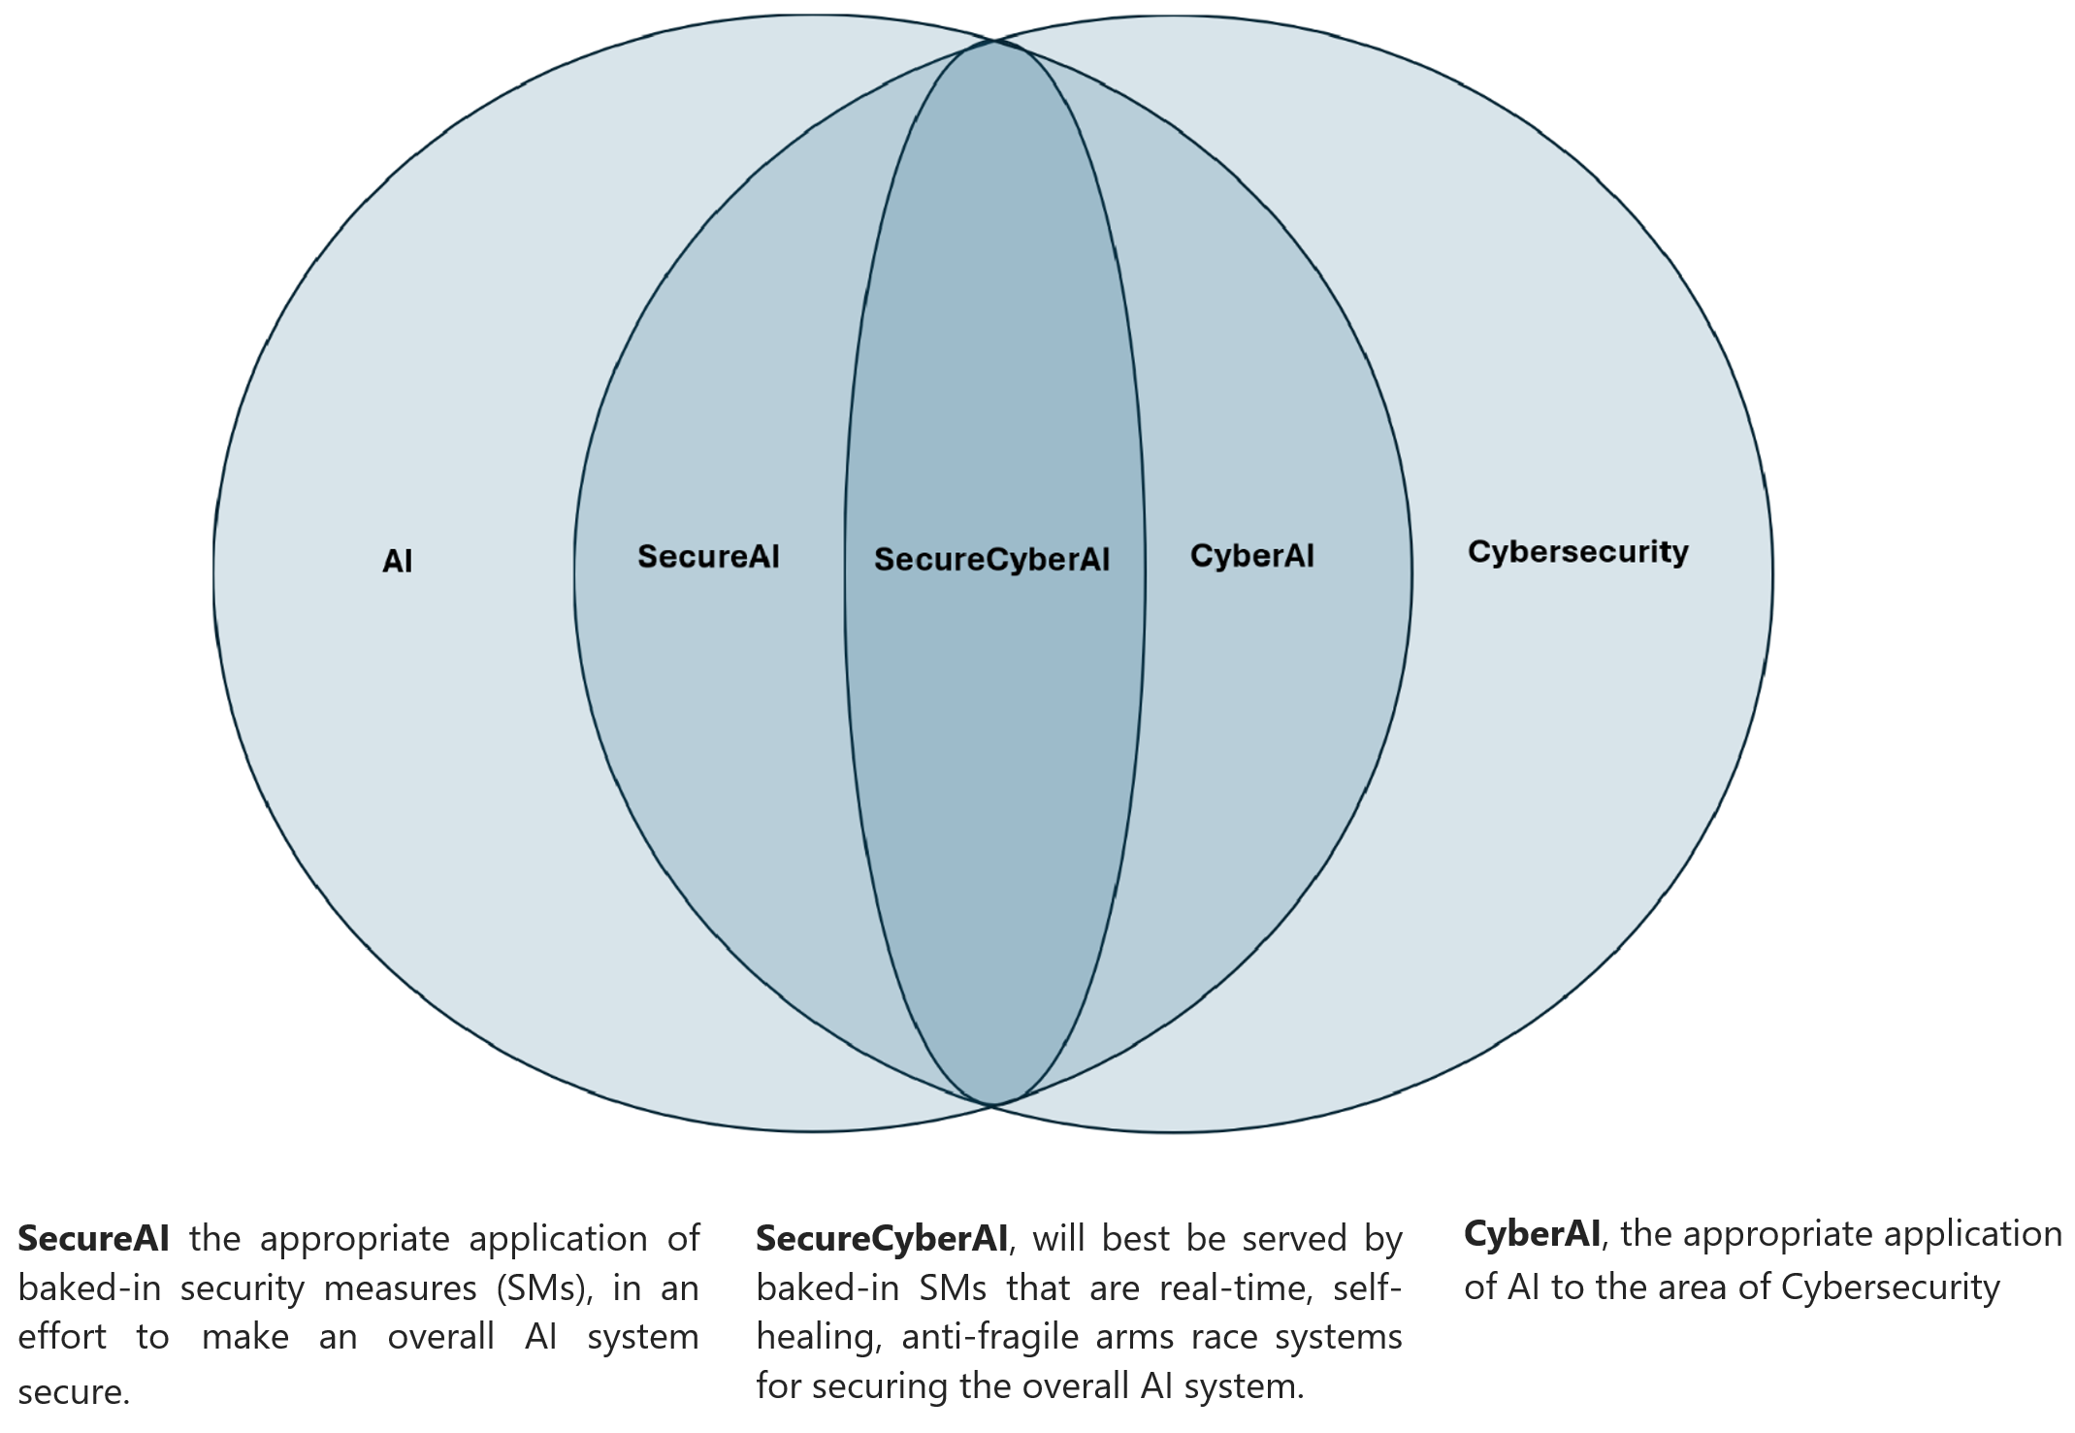
What We Uniquely Have to Offer
Cybersecurity
Excellent Research & Educational Programs
3 CAE Designations
NSF SFS
Artificial Intelligence
Excellent Research & Educational Programs
NSF AI-SFS (Coming Soon!!!)

Slide 5
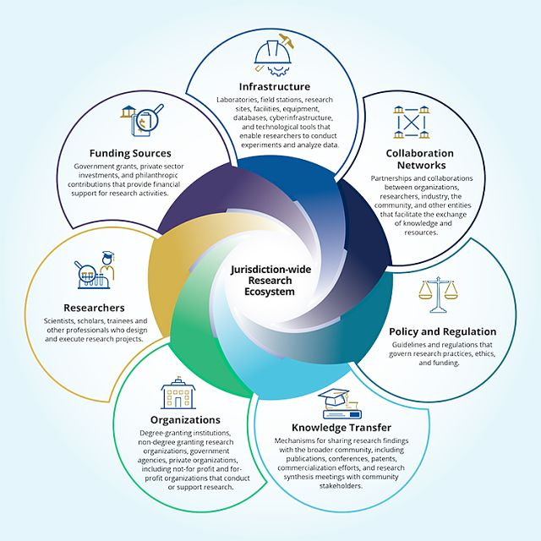
NSF 23-587: EPSCoR Collaborations for Optimizing Research Ecosystems Research Infrastructure Improvement Program (E-CORE RII) Deadline: July 15, 2025
Funding Level: $8M over 4yrs (can be renewed)
Objective: “Build research capacity in one or more research infrastructure cores that underlies the jurisdictions ecosystem.” [p. 3]
Research Cores:
Administrative Core (Required) [p. 9]
11 Additional Cores [pp. 9-10]
Source: https://www.nsf.gov/funding/opportunities/e-core-epscor-research-infrastructure-improvement-program-epscor/nsf25-523/solicitation

Slide 7
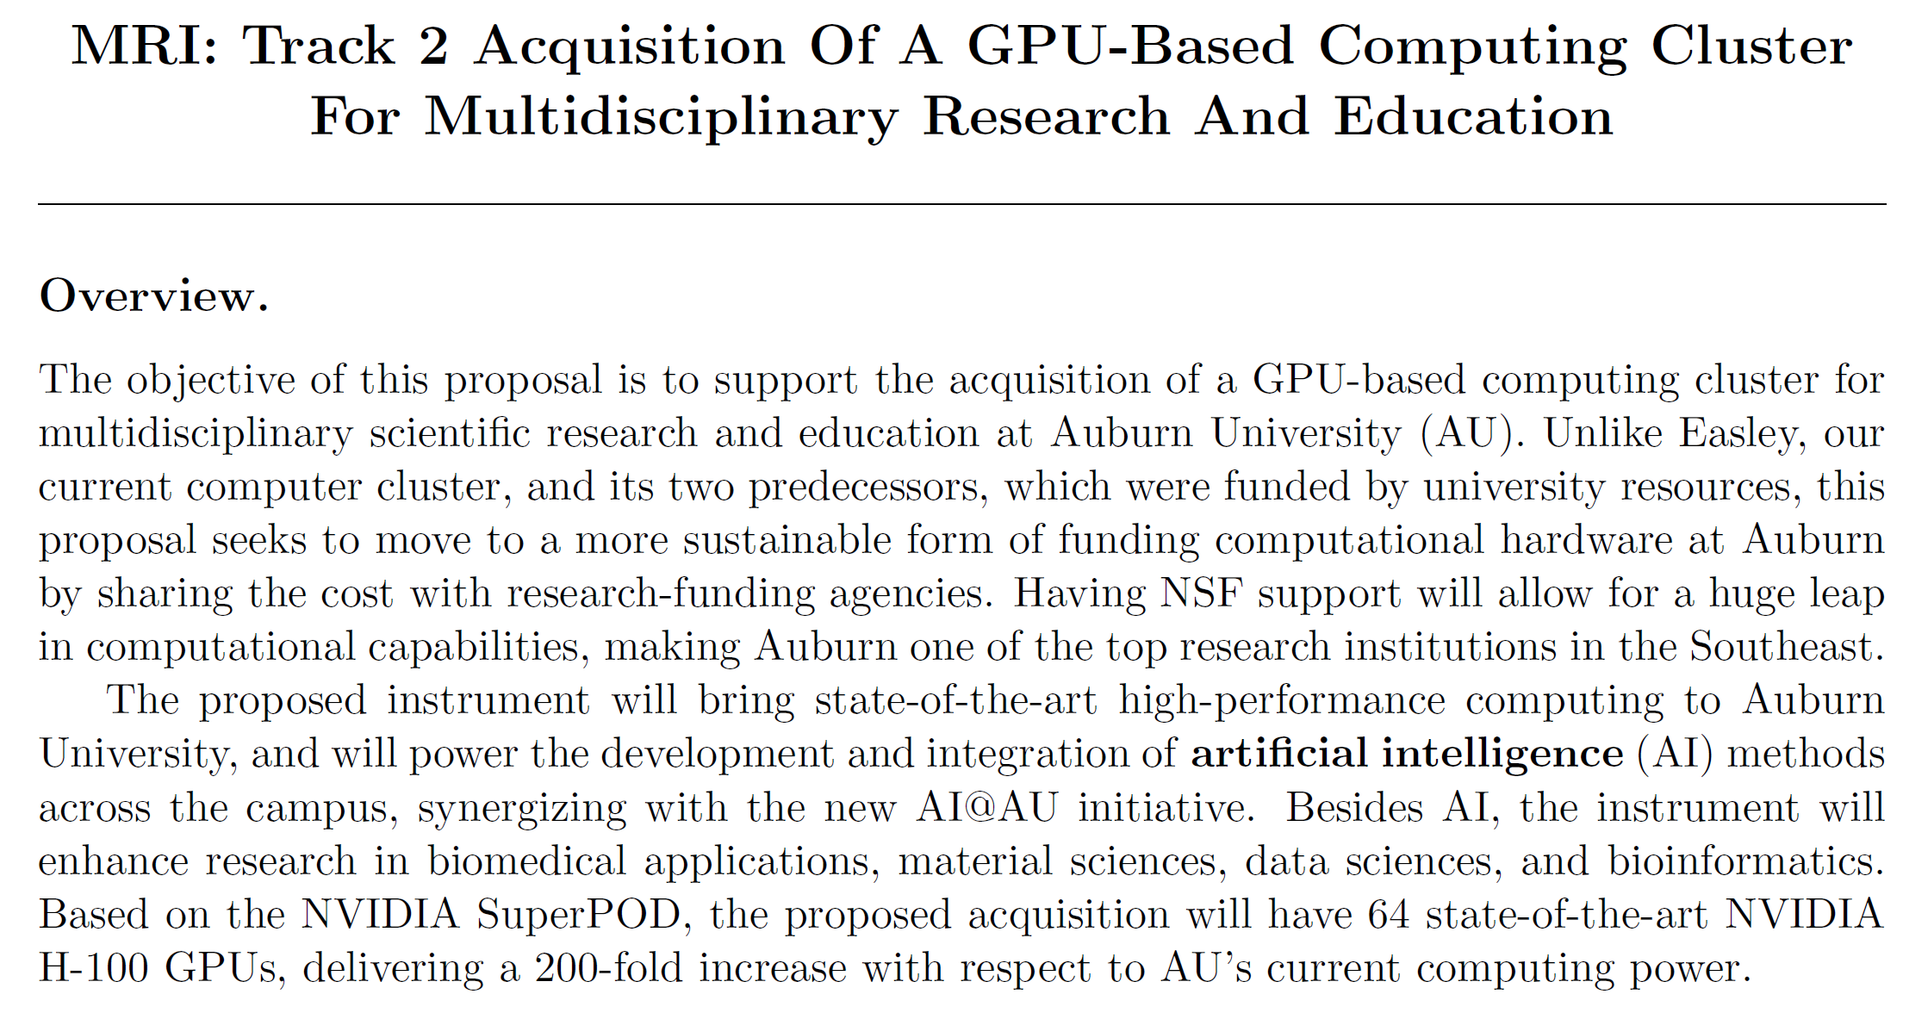
NSF 23-519: MRI Deadline: October 15, 2025 – November 14, 2025
PI: Rafael Bernardi
Co-PIs: Alice Smith, Jennifer Robinson, Marcelo Kuroda, Gerry Dozier
Rafael asked AU-CAICE to lead this effort for the 2025 cycle
Requested Amount: $3,979,460

Slide 8
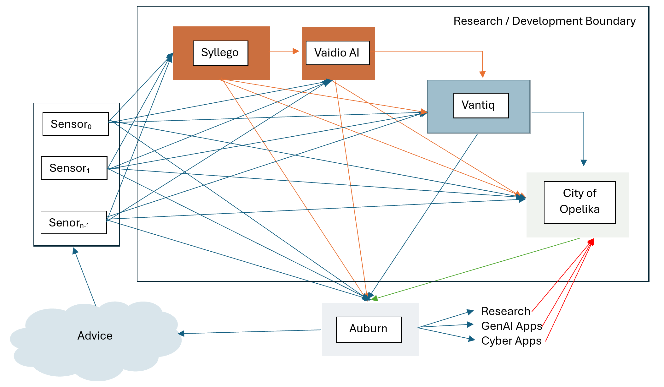
City of Opelika Testbed
Focus Areas
Traffic Analysis & Management
Crime & Public Safety
Problems to be Addressed
Anomaly Grounding (Nguyen)
Sensor Layout Optimization (Kandah)
Data Collection Policy & Privacy (Kandah)
Traffic Multiview Camera Analysis (Pan He)
City of Opelika AI ChatBot (TBD)
Approximate Project Cost (Yearly)
$30k for Faculty
$5-10k for Equipment
$70-140k (2-4 Students)
Total ≈ $105k to $180k
Project Duration ≈ 1-2yrs

Slide 9
?
Thank You!!!

